Slide 1
REEV Project High-level Alignment

Slide 2
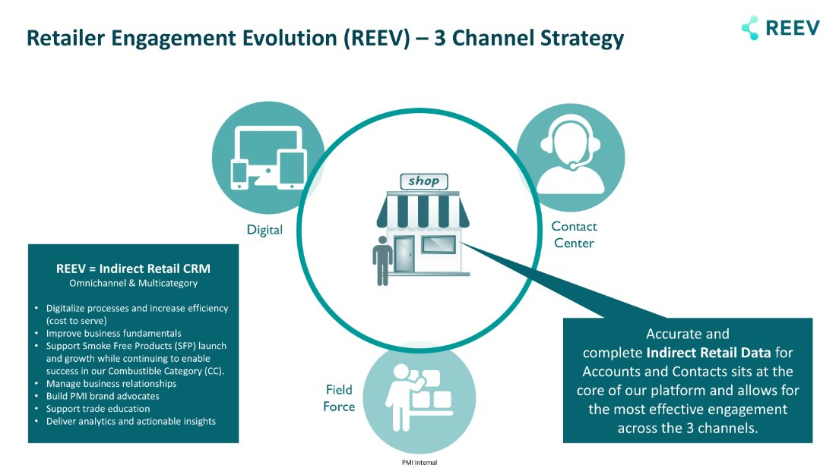
Out of Scope
Out of Scope
* Potentially, Call Center would support low-rank CVS in future.
Scope

Slide 3
Approach for Project – Trade Activity Enhancement
AS-IS
TO-BE
No change
To be changed / implemented
Simple and Integrated UI
for FE Activity
Reporting, incl. Master Data Management
Operation
Interdependency
Fit Analysis
AS-IS
Global Solution
REEV / FF1
System
Refer
Understand AS-IS operation and System Flow
Prepare TO-BE operation flow and reporting format (flexibility per KPI)
Fit analysis between TO-BE operation and Global solution during workshop
Align project timeline including Go/No-Go decision after workshop, based on fit analysis and its business impact

Slide 4
Trade Activity High-level Plan (as of 2024)
Plan
Action
Analysis
Set Call Plan combining B2C GT/GS activities
Recommend route plan including transportation time and prioritization (e.g. google map navi)
Adjustable depending on conditions (e.g. working hours, break-time)
Power BI Reporting filtered by
Per Outlet
Per day (daily trend)
Show NBA (which activity is recommended)
NBA
Dynamic Contents for negotiation per NBA
Trade Visit Check-in and result input
Recommend planogram based on AS-IS facing
In-Store stock counting

Slide 5
Project Organization
Steering Committee
Joel, Marco/Jon, Stephane,
Kei, Tamao
Project Lead
Ota
OC / RHQ Business Partners
PMO
Sub Project Lead
Operation
Nasu
IT
Yuki
Sub Project Lead
Reporting
Danny
Linked to DPaaS
JP24P3A-0115 |
FSF
Moo, Chiba
OC IT
Local IT
Honda, So, Haruka
CI&A
Sobitha
CP – FSF
Fujioka
FIN
Hanae, Gao
CCD
(from 2026)
CP – Perf. Mgt
Hirane

Slide 6
Timeline
 | 2025 |  |  |  |  |  |  |  | 2026
 | May | Jun | Jul | Aug | Sep | Oct | Nov | Dec | Jan | Feb | Mar | Apr | May | Jun | Jul | Aug
Japan Internal Kick Off
AS-IS vs TO-BE (High-Level Operation)
Fit Analysis Workshop with OC
Go/No-Go Decision based on workshop
Business Case Scope of OC or Local + High-level BRD Prioritization BRD in detail Biz Design Solution Design Resource Allocation
2026 OB
DISD / 650 / IT CAPEX
Change Mgt Plan
Global Development
Local Development
Training
UAT / Sanity Test
Go-Live
AiS Decommission
DPaaS
From AiS
From REEV

